Slide 1
San Francisco Airbnb
Partha Mehta

Slide 2
Introduction

Slide 3
Problem Statement
Simplifying the SF Airbnb Search Process
Our goal is to develop a model that allows customers to find suitable Airbnb’s in the city of San Francisco based on pre-selected features such as bedrooms, neighbourhood, price and more. While the Airbnb website offers a few filters to search with, our model goes beyond filtering, exploring similarities across neighbourhoods. Customers also have the option to narrow their search based on how our model clusters Airbnb’s!

Slide 4
Project Context & Motivation
By developing a recommendation model that suggests Airbnb’s as per personal choices, we can help various types of customers select Airbnb’s from myriads of options available in San Francisco that be-fit their preferences in a more efficient manner.
Such a recommendation tool and a user-interactive interface enables user-friendly service and attracts more customers to utilize it.

Slide 5
The Data

Slide 6
The Raw Dataset
The datasets:
listings.csv.gz
reviews.csv.gz
These files were downloaded and obtained through the Inside Airbnb website. It contains publicly sourced, cleansed and aggregated data directly from the actual Airbnb site.

Slide 7
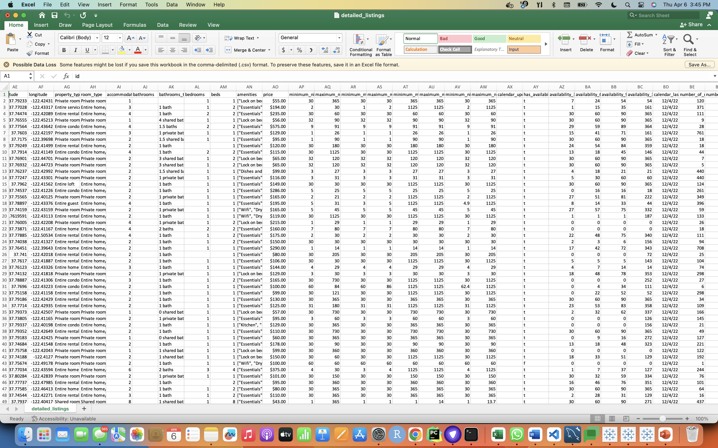
The Raw Dataset: listings.csv.gz
listings.csv.gz contains 6789 rows x
75 columns
Contains detailed data on SF Airbnb’s:
listing id, host name, total host listings,
neighbourhood location, min/max nights
stayed, availability, number of beds /
bathrooms, customer review scores,
listing price, etc.

Slide 8
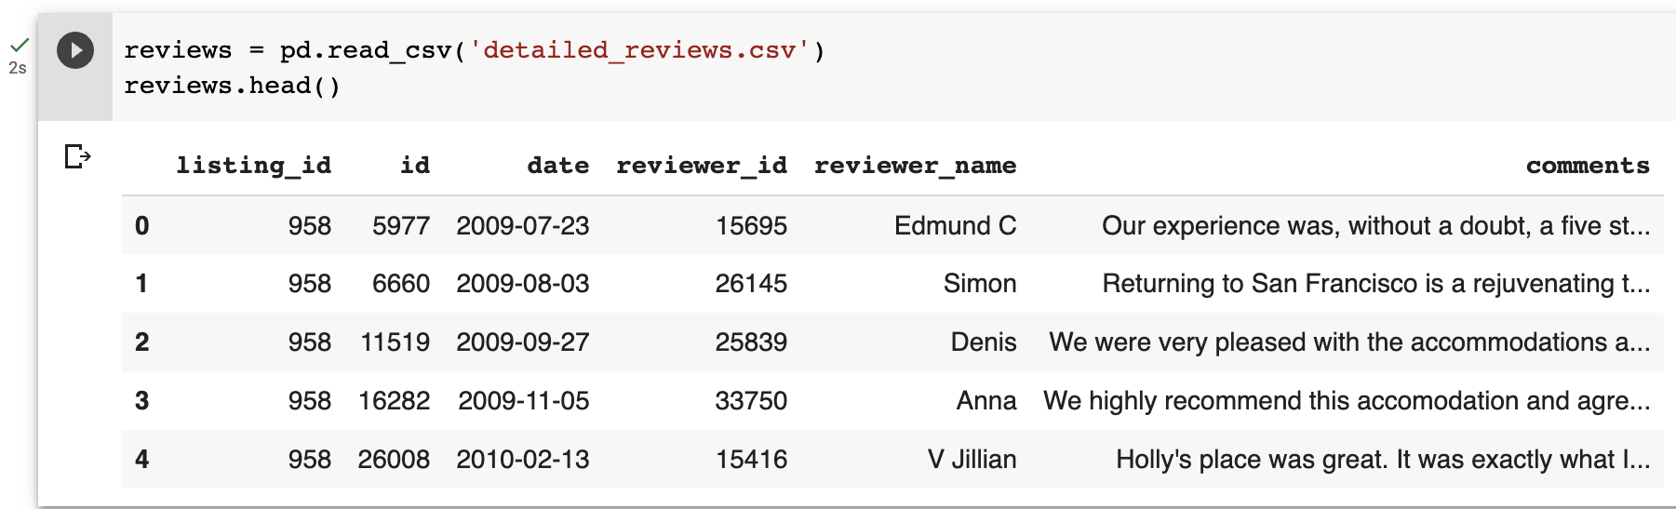
The Raw Dataset: reviews.csv.gz
reviews.csv.gz contains 330349 rows x
6 columns
Contains information about customer reviews:
date reviewed, name of the reviewer, listing id,
reviewer id, and user’s comments.

Slide 9
Approaches & Algorithms

Slide 10
The Approach
Data Cleaning / EDA
TF – IDF
Sentiment Analysis
K-Means Clustering
User Interface (Results)

Slide 11
Data Cleaning / EDA
First, we performed an inner join on listings.csv.gz and reviews.csv.gz
Next, we dropped unnecessary columns:
The columns were: 'listing_url', 'scrape_id', 'last_scraped', 'id_x','host_url', 'host_thumbnail_url', 'neighbourhood_group_cleansed', 'minimum_minimum_nights', 'maximum_minimum_nights', 'minimum_maximum_nights','maximum_maximum_nights', 'minimum_nights_avg_ntm', 'maximum_nights_avg_ntm', 'calendar_updated', 'license', 'id_y’
From the simplified joined table, we looked only at listing_id and comments, grouping comments by each listing to gather customer opinions on each listing
Finally, we separated the joined table based on categorical and numerical values (used for EDA in next few slides)

Slide 12
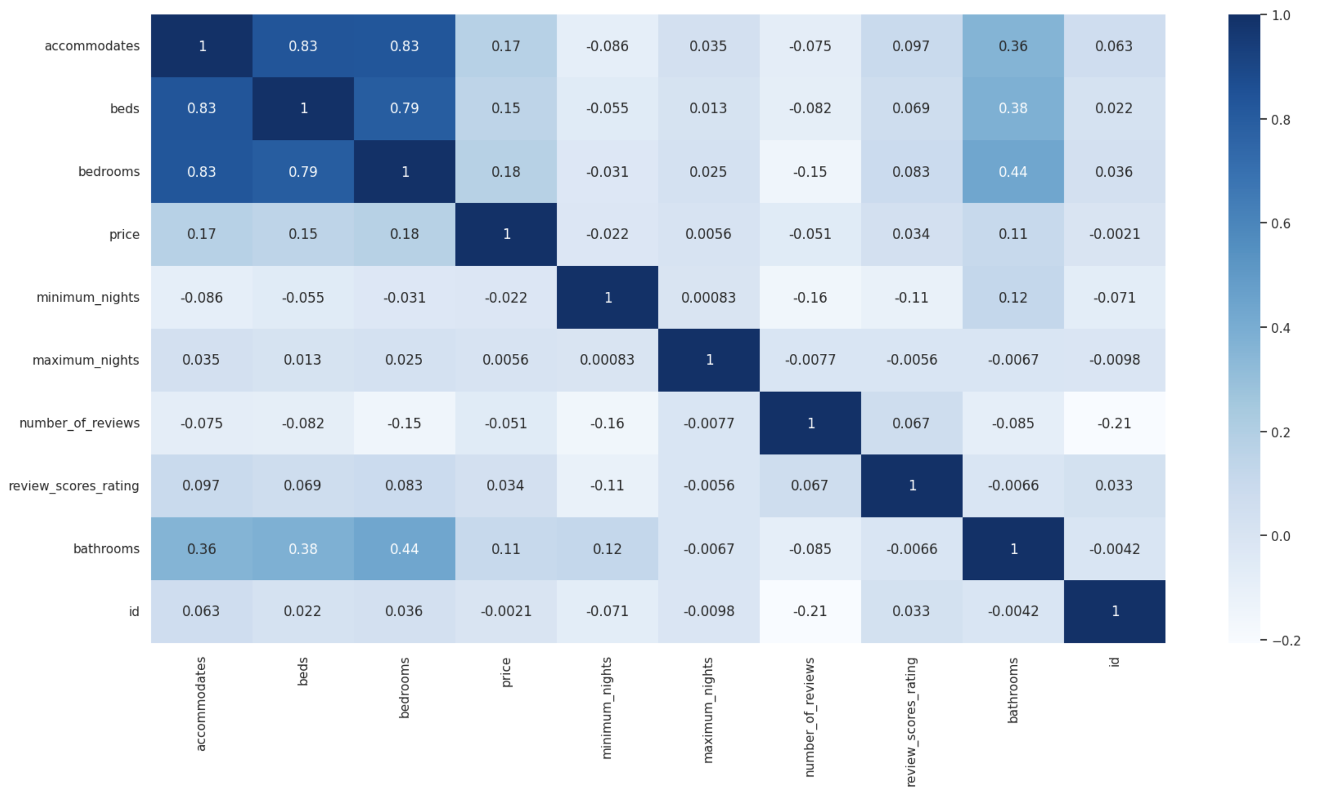
Correlation Analysis
SF Airbnb’s that have more beds, bedrooms and bathrooms tend to be booked by users with large
Numbers of occupants, with correlations 0.83, 0.83, and 0.36 respectively.

Slide 13
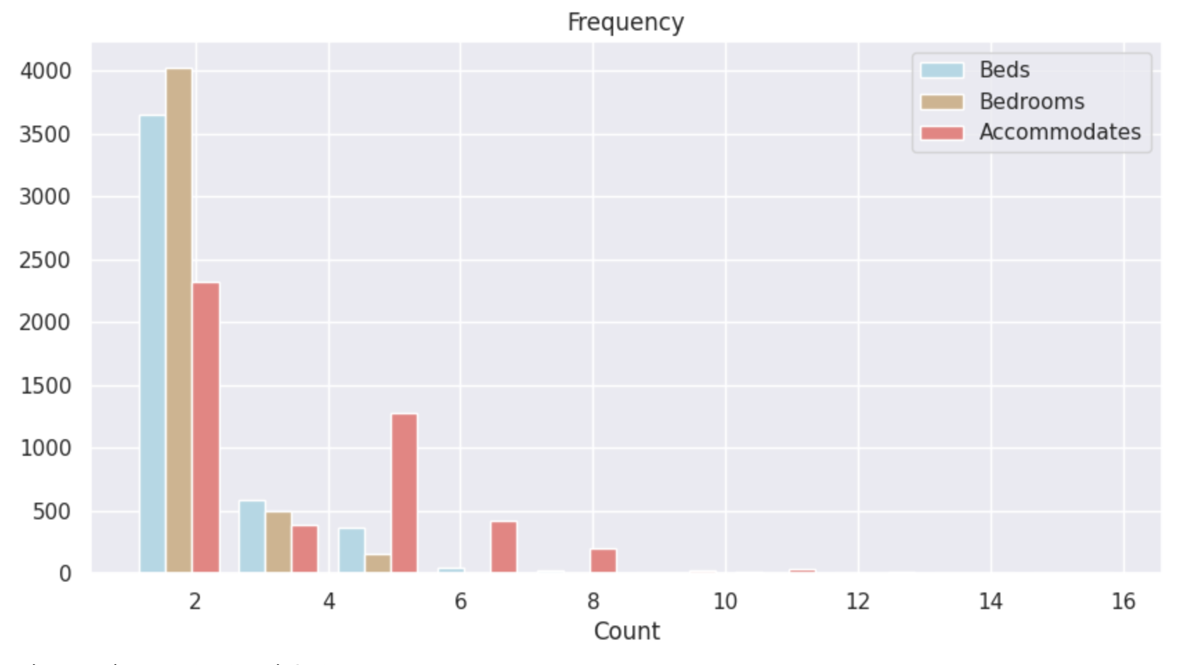
Data Visualizations
We wanted to understand how the Airbnb’s differ based on beds, bedrooms and accommodation.
It’s quite clear that most Airbnb’s are meant for up to 2-4 people with a few that go above 6.

Slide 14
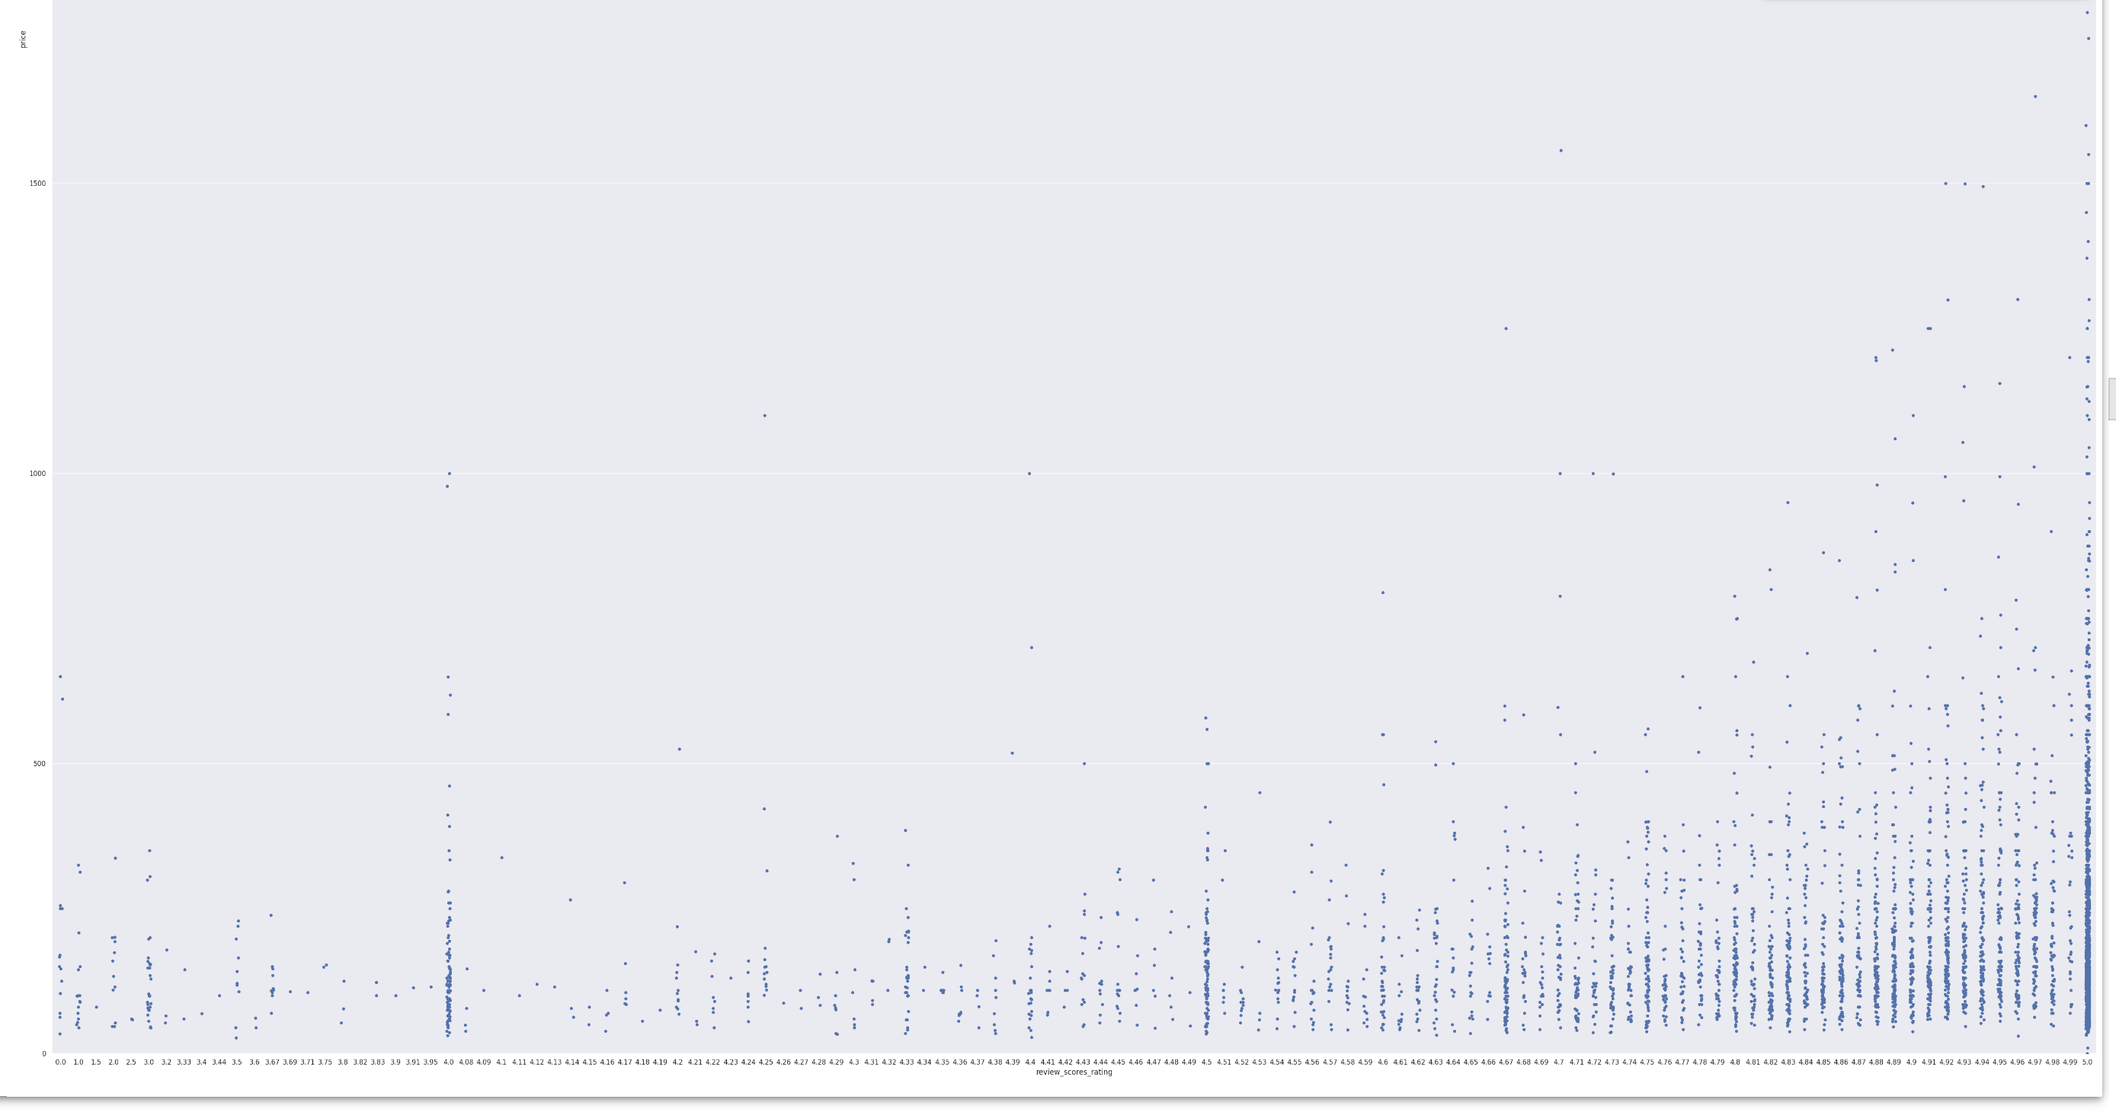
Data Visualizations
It seems that higher ratings given by reviewers address pricier Airbnb listings as compared to lower ratings.

Slide 15
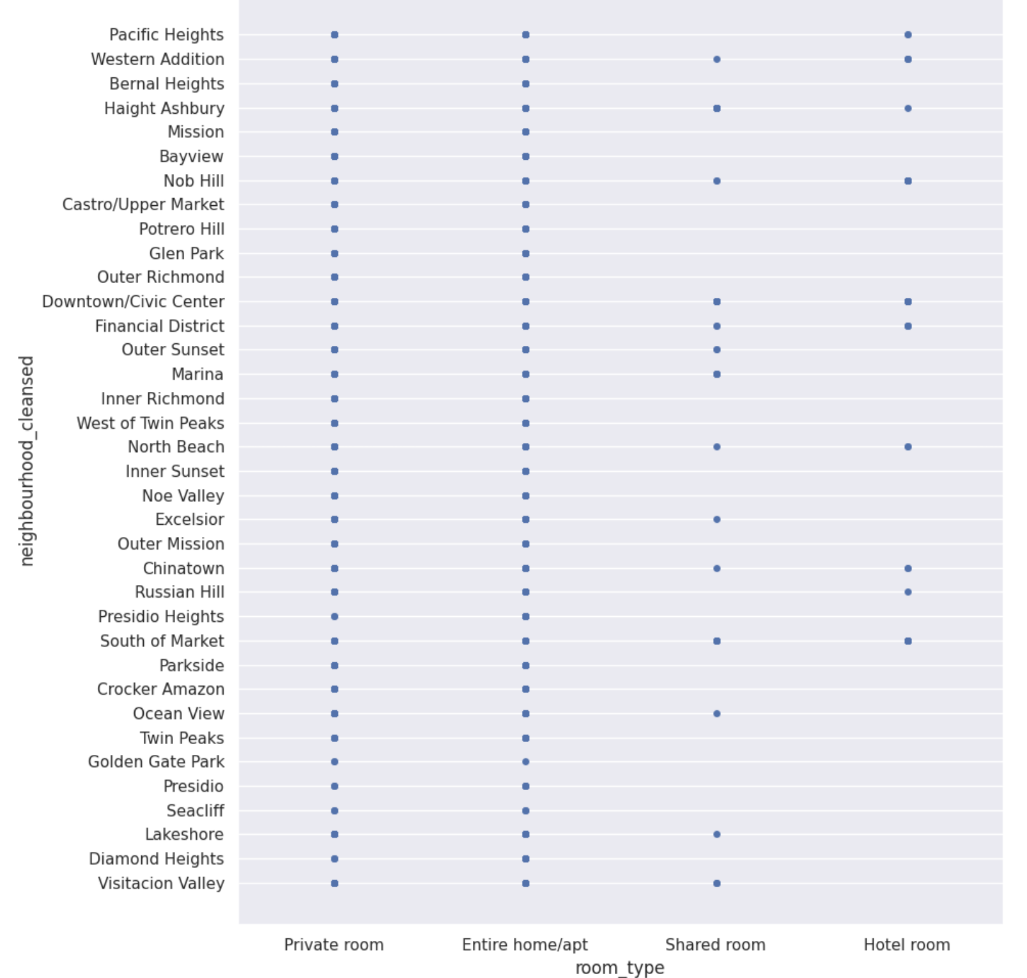
Data Visualizations
San Francisco Neighbourhoods
Almost all neighbourhoods offer entire homes /
Apartments, and many offer private rooms as well. With few shared rooms available, it is also not as spread out in the city.

Slide 16
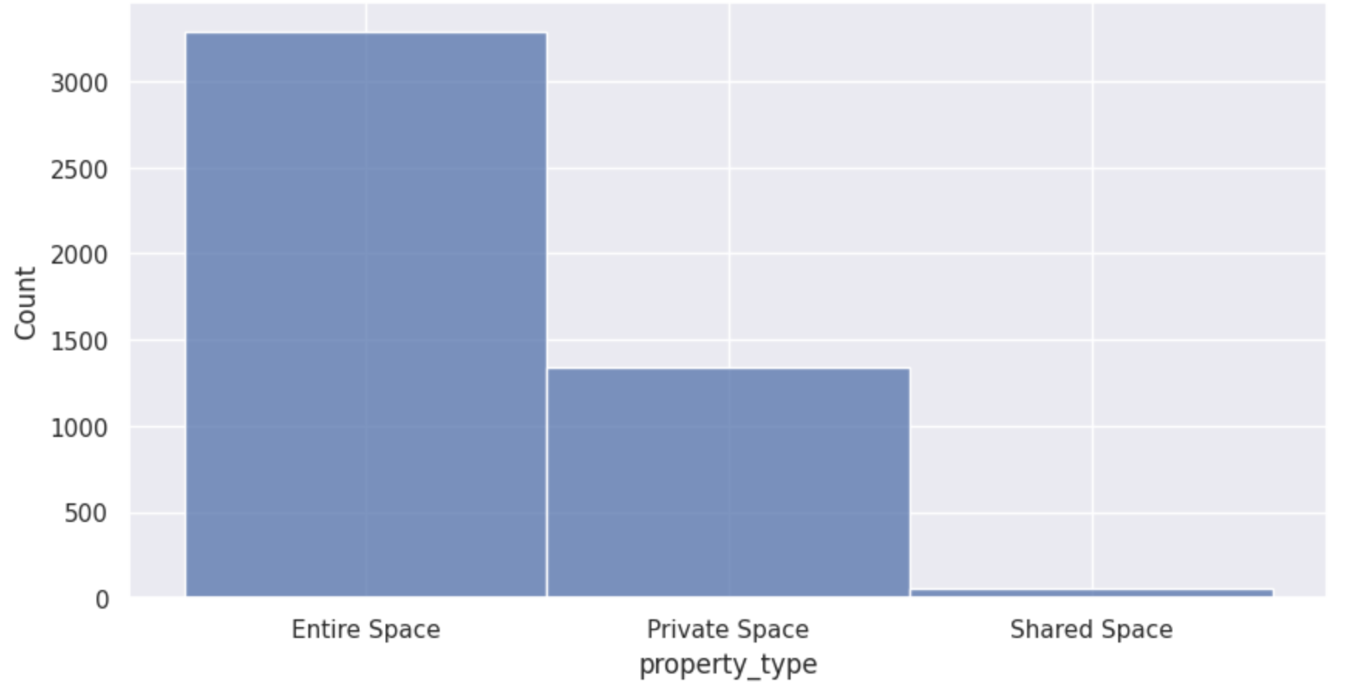
Data Visualizations
Most Airbnb’s provide the entire space for stay, and very few offer shared spaces, however it
does exist.
How many of each property type?

Slide 17
Approaches & Algorithms

Slide 18
Approach & Algorithm – Part 1
TFIDF
We used TF-IDF to quantify the Airbnb descriptions provided by hosts and use it for clustering the listings.
Sentiment Analysis
Goal: To understand how positive or negative users’ experiences were with their stay at the different Airbnb’s
Preprocess the text:
Lowercase, special characters, stopwords, stemming
Calculate sentiment score (polarity range: -1 to 1)

Slide 19
Approach & Algorithm – Part 2
3. K-Means
Objective: Use K-means algorithm to group similar Airbnb’s into clusters based on a combination of key numerical features and text analysis
Calculated TF-IDF scores on Airbnb descriptions provided by the hosts
Performed sentiment analysis on Airbnb reviews by users to account for user experience
Perform recursive clustering on a user’s preferred group of Airbnb’s to develop more distinct groups of similar Airbnb’s
This allows user to refine their search at each level.

Slide 20
Results & Conclusion

Slide 21
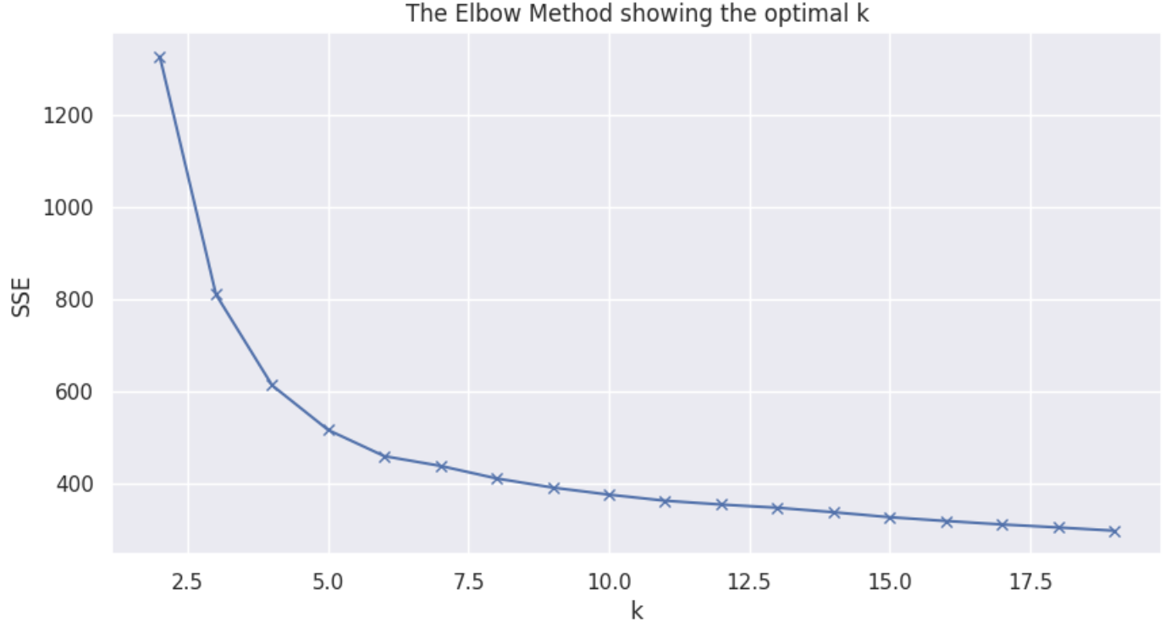
Results - KMeans
Optimal no. of clusters using elbow method: k = 5

Slide 22
Results – User Interface
Used Geopandas and Folium libraries to develop a map of Airbnb listings in San Francisco.
The map displays the different clusters of Airbnb’s in five different colors based on the results of the elbow method for finding the optimal number of clusters (k=5)
The user can move around, zoom-in/out, and click on a listing to see the details of the listing.
The map interface makes it easier for a user to retrieve information for similar Airbnb’s and decide which listing to book.

Slide 23
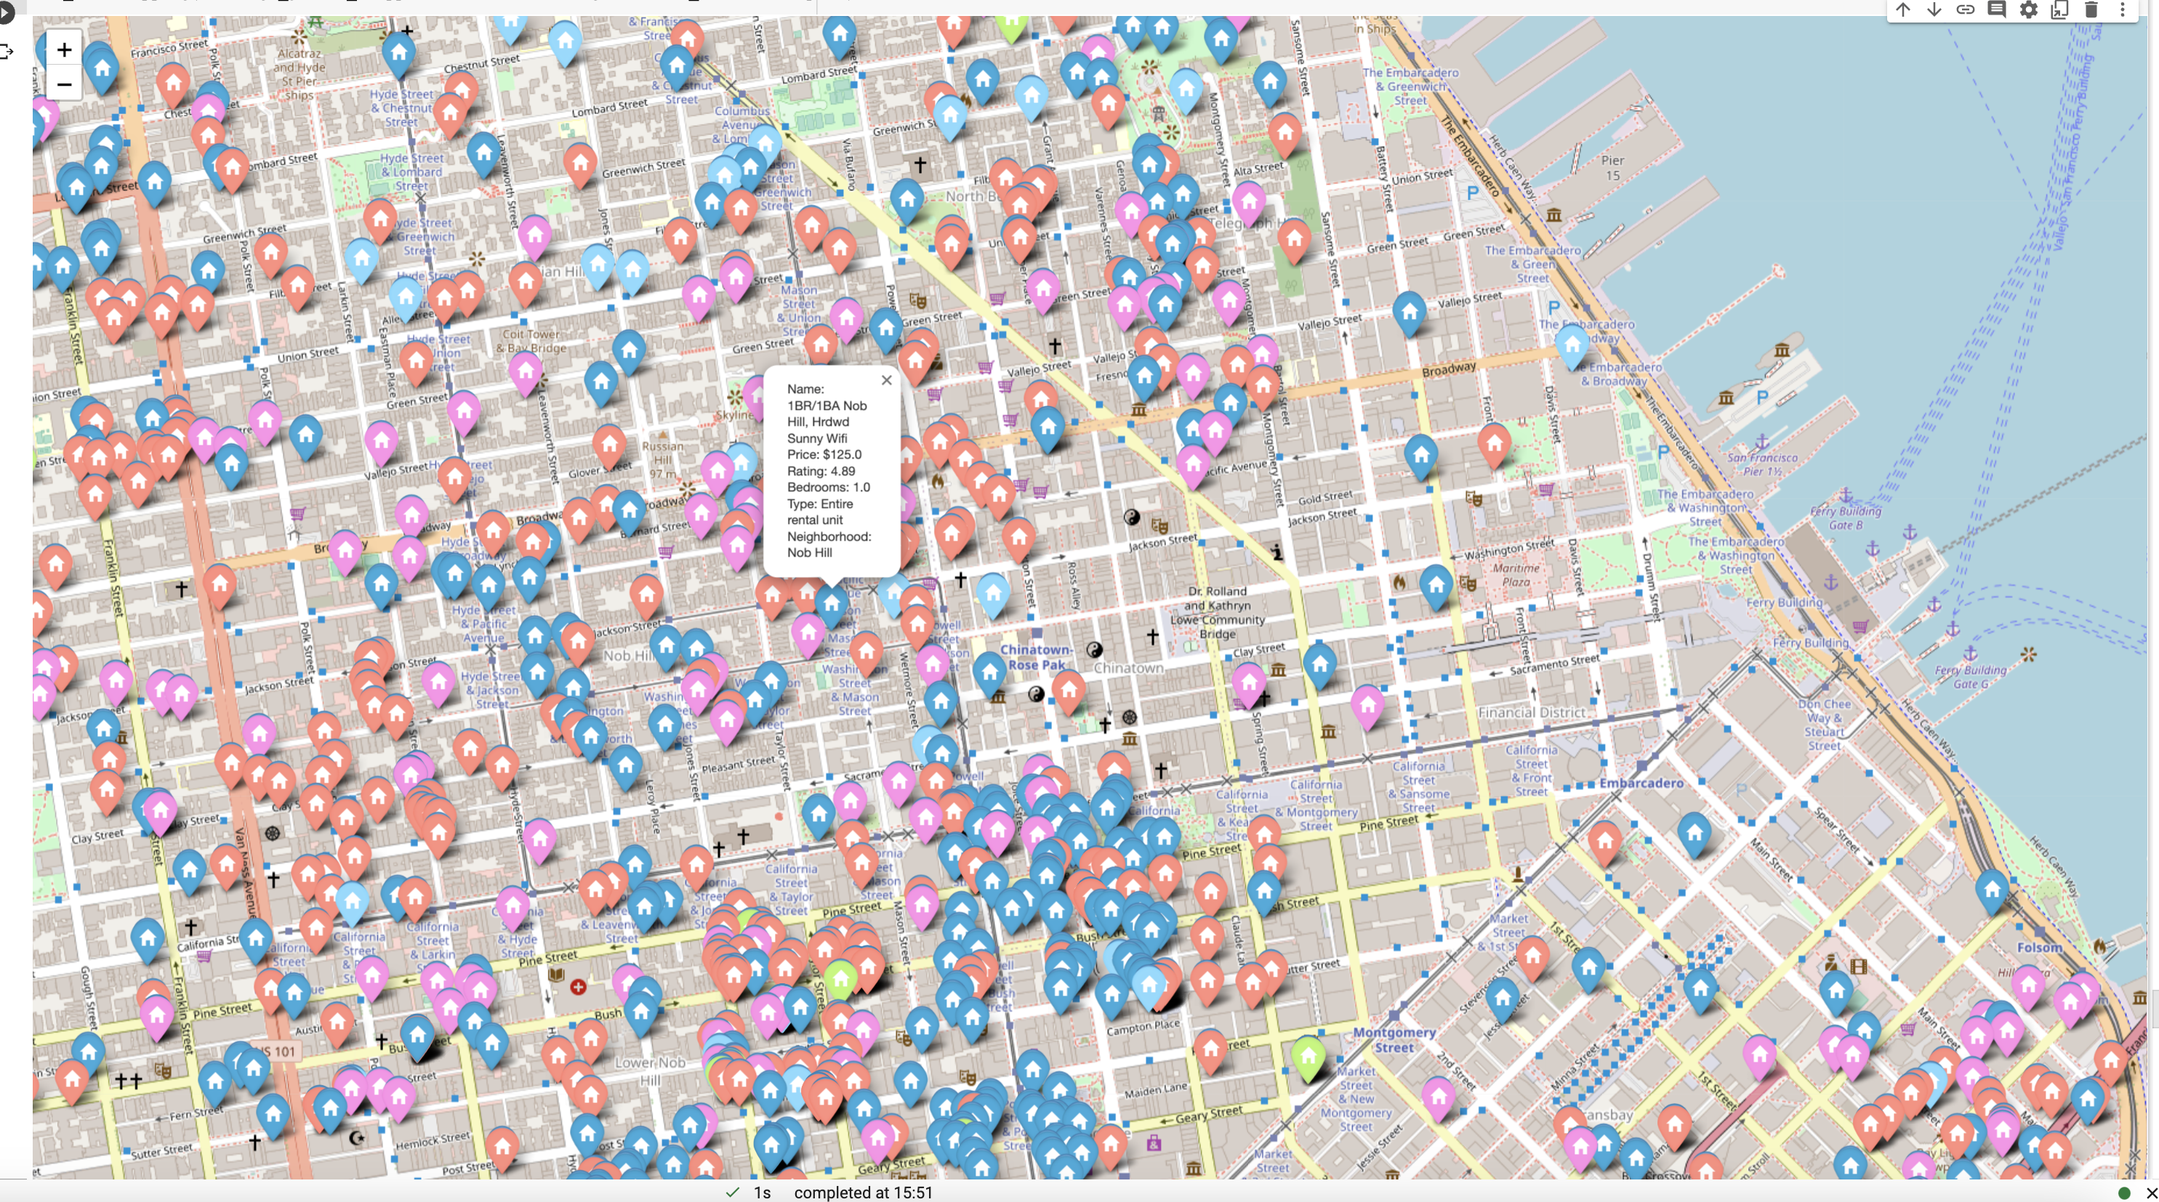
Map 1: Shows the clusters of all the Airbnb’s of San Francisco

Slide 24
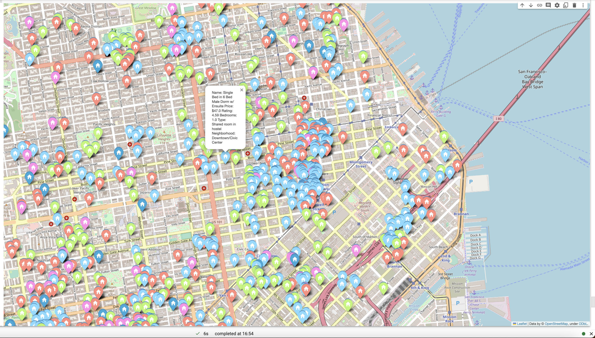
Map 2: After choosing group “blue”

Slide 25
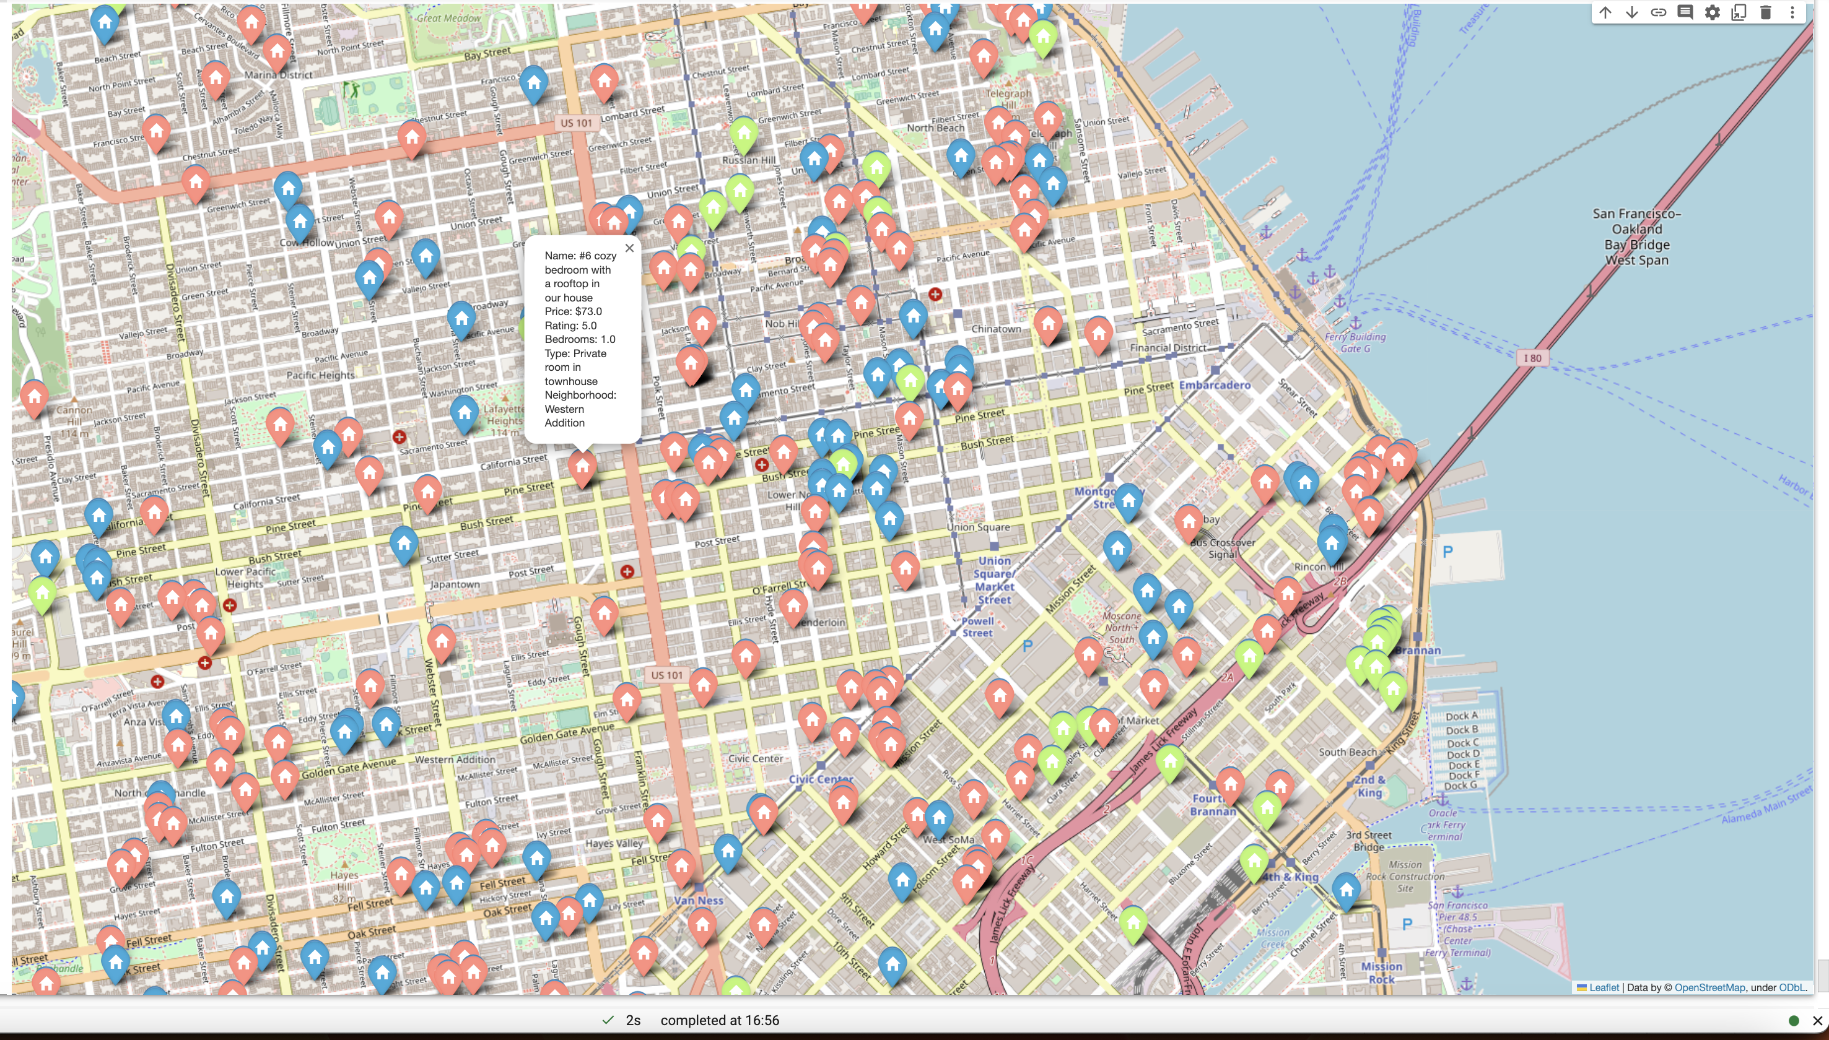
Map 3: After choosing group “pink”

Slide 26
Key Findings
Cluster 2 (lightgreen) had highest average price
Corresponds to highest average no. accommodations/beds/baths
But had lowest average TF-IDF & sentiment score
Clusters 1 (blue) & 3 (pink) had similar average price (also lowest)
Both had highest average TF-IDF score among clusters, though not significant to conclude anything
Cluster 3 can accommodate 1 more person on average but had lower review score
Clusters 0 (light red), 2 (lightgreen) and 3 (pink) had highest average maximum stay
Cluster 3 is with a lower price point and Cluster 0 with a higher price point
Clusters 2 (lightgreen) had highest average review score and 4 (lightblue) had second highest average review score but had lowest no. reviews
Average review sentiment scores is relatively stable across all clusters

Slide 27
Conclusion
Not all Airbnb’s within a neighbourhood are similar, as one may assume
Sentiment analysis on users reviews is not a good measure of UX -> bad predictor on similar Airbnb’s
Similar descriptions are not a good predictor of similar Airbnb’s
A slight difference in one feature can significantly affect assigned clusters
Optimal k changes as you recursively cluster or focus on a specific cluster
Next steps for improvement:
An option for users to select features they deem important and perform clustering based on user selected features
Improved UI for users to select & filter clusters

Slide 28
Challenges Faced…
The initial steps of this project that include data collections, processing and exploring were definitely the most time consuming bits – once you have so much data, figuring out next steps and making a plan to uncover insights is not as easy as it seems.
I wanted to incorporate as much knowledge from the online courses I have taken and also from past projects / industry experience as I could – learning concepts is simple, but applying them to different scenarios is where it gets interesting.
Modelling is not as simple as writing a couple of lines of code – for a model to work elegantly, fine-tuning and understanding its effect on each feature is important. While our K-Means model does quite well, we know there’s place for improvement, through more tuning for more depth in learning.

Slide 29
Thank You!

Slide 30
Appendix
Data source:
http://insideairbnb.com/get-the-data.html
Link to code (Colab Notebook):
https://colab.research.google.com/drive/1md34PrP1MP5Abyk_GkGSfj74x3sqfUgr

